Slide 1
Leads/Lags, Constraints and Calendars
Module 04
That which we persist in doing becomes easier for us to do; not that the nature of the thing itself is changed, but that our power to do is increased.’ –Ralph Waldo Emerson

Slide 2
Agenda
Where are we on the Schedule Development Stages
Leads/Lags
Deadlines
Constraints
Calendars
WBS codes
Review Term Project Groups and Second Assignment

Slide 3
Schedule development Stages
Task Entry (Module 1)
Project Level Task
Task Logic (Module 1 & 2)
What order are the activities (tasks)?
Task Constraints (Module 2)
Resource Creation and Allocation (Module 3)
Schedule Balancing (Module 5 & 6)
Triple Constraint Management
Sub-Deliverables
Work Packages/Products
Activities
Milestones
Support Activities (Meetings)
Task Relationships:
- What task is next?
- What task are we waiting for?
Is there a delay before next task
What must happen on a particular date?
What must happen before/after a date
When should I finish this task
What People (work) resources
What machines (work)
What materials (materials)
What extra costs (costs)
Overallocation of resources removed
Schedule dates met
Cost Constraints met
Variances
Analyze
Adjust
Reporting/Exporting/Importing

Slide 4
Leads and Lags
Understand how to use leads and lags
Add a lead or lag to a task relationship

Slide 5
Leads and Lags
Lead and lags are used to better manage the relationships in a project schedule.
Lead accelerates the start of the successor relationship.
It is best used on finish to start (FS) relationships
Lag delays the start of the successor relationship
Can be used on all relationship types (FS, SS, SF, FF).

Slide 6
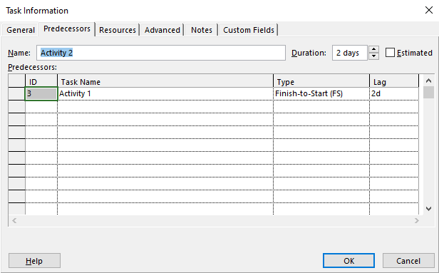
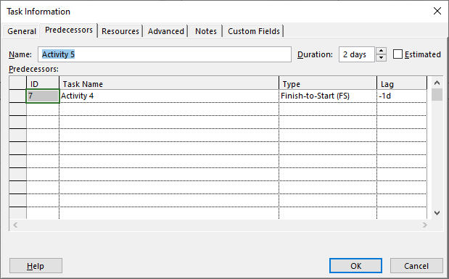
Leads and lags
Task Information Dialog
Predecessors Tab
Lag of 2 days
Lead of 1 day

Slide 7
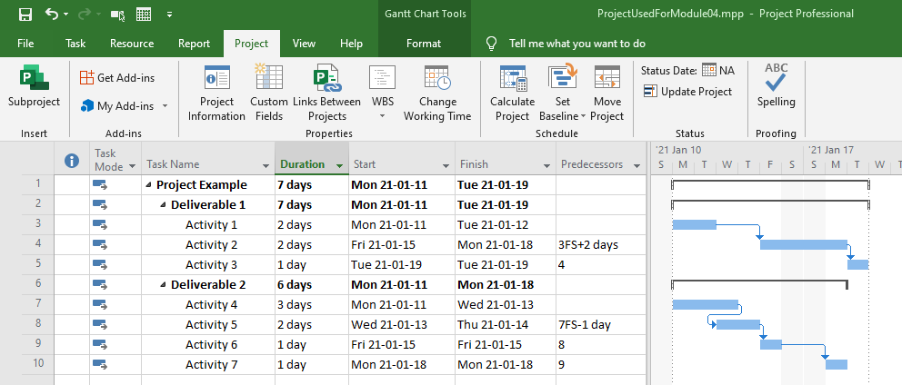
Lag
Lag of 2 days
Lag of 2 days
Notes:
Image Source: Bunin, New Perspectives on Microsoft Project 2010

Slide 8
lead
Lead of 1 day
Lead of 1 day
Notes:
Image Source: Bunin, New Perspectives on Microsoft Project 2010

Slide 9
Lead/Lag Example
Insert a lead by using the Predecessor tab on the task Info dialog.
Insert a lag by typing it in.
Show the effect on the Gantt chart

Slide 10
Deadlines and Constraints
Understand the concepts of deadlines and constraints
Add a constraint to a relationship

Slide 11
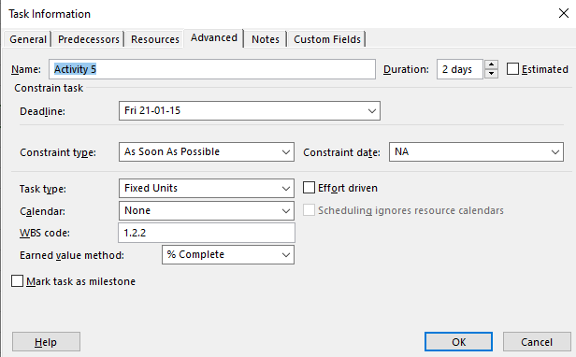
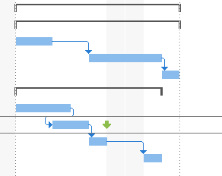
Deadlines
A non-restricting constraint that is purely informative.
Deadline date
Deadline date

Slide 12
Constraints
Constraints put restrictions on MS Projects ability to move tasks as durations, start/finish dates and relationships change.
When Project tries to update a task in a project in must respect the constraints that are set for that task.
Constraints should only be used when absolutely necessary when planning a project in order to maximize schedule flexibility
There are 3 types of constraints:
Flexible
Semi-flexible
Inflexible

Slide 13
Flexible Constraints
Constraint | Type | Description
As Late As Possible (ALAP) | Flexible | The task starts as late as it can without delaying other tasks. This is the default constraint when you schedule from the project finish date.
As Soon As Possible (ASAP) | Flexible | The task starts as soon as possible. This is the default constraint when you schedule from the project start date.
Don’t have specific dates associated with them
Tasks can be moved either direction by MS Project
Source: MS Project 2013 help

Slide 14
Semi-Flexible Constraints
Constraint | Type | Description
Start No Earlier Than (SNET) | Semi-Flexible | The task starts on or after a specific date.
Finish No Earlier Than (FNET) | Semi-Flexible | The task finishes on or after a specific date.
Start No Later Than (SNLT) | Semi-Flexible | The task starts on or before a specific date.
Finish No Later Than (FNLT) | Semi-Flexible | The task finishes on or before a specific date.
Require a start or finish date -- MS Project will assign the start/finish date to satisfy this condition
Tasks can be moved in one direction by MS Project
Source: MS Project 2013 help

Slide 15
Inflexible Constraints
Constraint | Type | Description
Must Finish On (MFO) | Inflexible | The task finishes on a specific date.
Must Start On (MSO) | Inflexible | The task starts on a specific date.
Require you to enter a specific date that a task must start/finish on
Tasks can not be moved by MS Project
Source: MS Project 2013 help

Slide 16
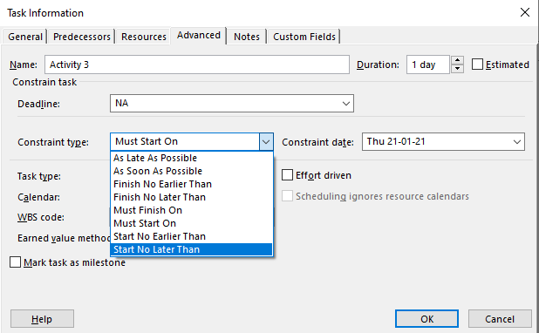
Constraints - Adding
Constraint Type
Constraint Date

Slide 17
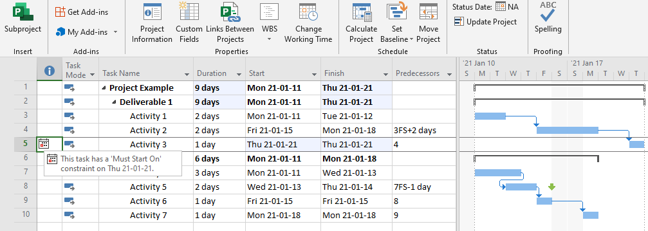
Constraints
Constraint Impact
Source: Bunin, New Perspectives on Microsoft Project 2010

Slide 18
Deadline and Constraint Example
Deadline
Add a deadline
See the Gantt Chart impact
Constraints:
Add constraint of type “must start on”
View indicator column detail
View impact on Gantt Chart

Slide 19
Calendars
Understand how to add a calendar
Understand how to add an exception
Understand how to change default working hours/days

Slide 20
Project and Task Calendars
Standard Calendar: default calendar, Monday-Friday are working days, 8 hours of work per day. Can change based on working requirements.
Task Calendar: can be created for specific tasks that don’t follow the project calendar
Resource Calendar: can be created for specific resources that don’t follow the project calendar

Slide 21
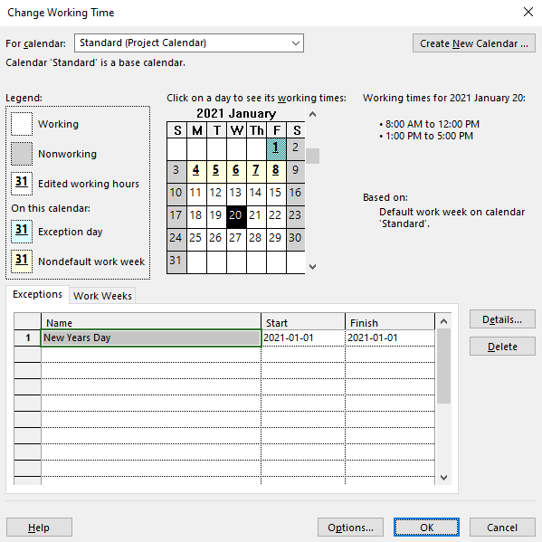
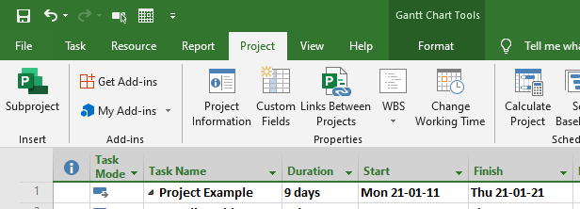
Calendars
Exceptions: Used to for Holidays, Vacations or short exceptions to work schedule
Click on any day to see working time
Work Week: Used to for change working hours for significant time periods. Examples: working half days, short term leave, etc.
Click on Change Working Time
Exceptions
Changes to work week
Source: Bunin, New Perspectives on Microsoft Project 2010

Slide 22
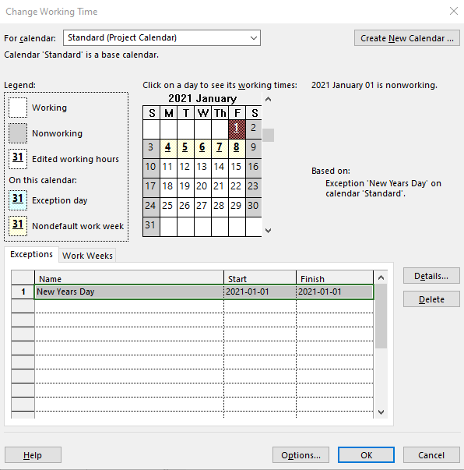
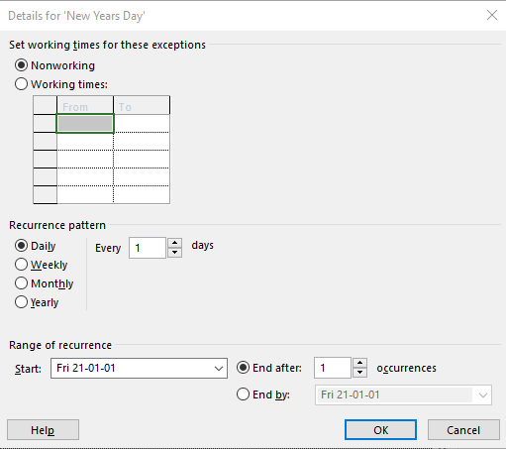
Calendar - Exceptions
Non working
Click on Jan. 01
Click on Details
Details Shown
Source: Bunin, New Perspectives on Microsoft Project 2010
Notes:
Image Source: Bunin, New Perspectives on Microsoft Project 2010

Slide 23
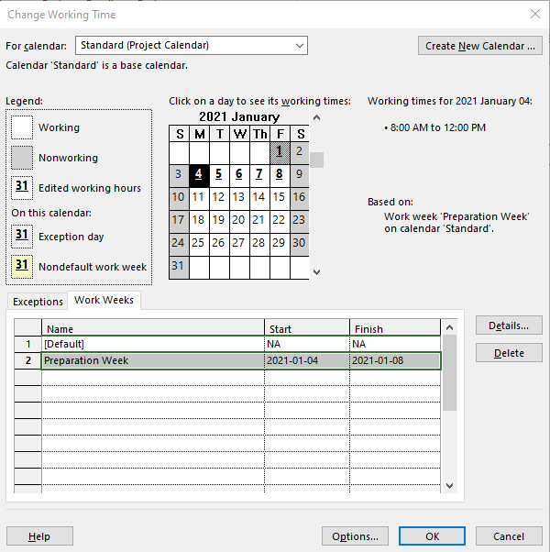
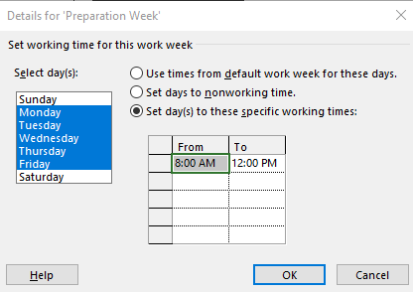
Calendar – Work Weeks
Hours shown
Alternate work week shown
Click on Details
Details Shown
Source: Bunin, New Perspectives on Microsoft Project 2010
Notes:
Image Source: Bunin, New Perspectives on Microsoft Project 2010

Slide 24
WBS Codes
Add WBS codes to any table
Specify/Modify WBS code format

Slide 25
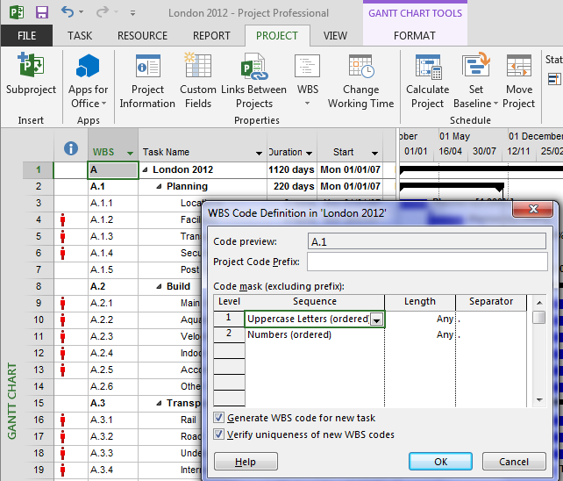
WBS Codes
To Create or Reformat WBS Code
To View WBS Code in Entry Table: Right click at top of column in Entry Table…Insert Column…then type WBS..

Slide 26
Group Project and Assignment
Understand group selection process
Understand the second assignment dates and requirements

Slide 27
Term Project Groups
Groups of 4
Self Enrollment available until Friday @ 5:00pm and then FOL will automatically put remaining students in groups.
NO CHANGES TO GROUPS after 5:00pm on this coming Friday!
Please read the Term Project – Part I assignment to ensure you understand requirements

Slide 28
AssignmenT #2
Key Information:
Must be completed during your class time.
Follow directions exactly and in order
Remember to save as directed in instructions (filenames matter)
You can submit it more than once if you realize that your first submission is not complete
Must be submitted by the end of your class time.
Late assignments will NOT be accepted
Please read Assignment #2 in the Assignments section of FOL for complete instructions.
Notes:
Review the assignment in detail.

